Slide 1
National Hydrology Project
Karnataka Surface Water
Chief Engineer
Water Resources Development organization
Government of Karnataka
WRD

Slide 2
SPMU Creation
Government of Karnataka has constituted SPMU for implementation of Surface Water component of NHP vide G.O. No. WRD /40/ NMS/ 2015(P1), Bangalore,Dated:02-03-2017.
Government has also constituted State Level Steering Committee for monitoring the implementation of NHP vide G.O.No.WRD/33/NMS/2017,Dt:24-04-2017

Slide 3
Key personnel in Implementation of NHP in Karnataka
Project Co-ordinator Principal Secretary, WRD
Nodal Officer: Chief Engineer, WRDO
Training Co-ordinator: ACIWRM & KERS
Project Director: Superintending Engineer (Hydrology Unit) WRDO
WRD

Slide 4
Details of SPMU
Sl.No. | Position | Designation | Staff strength in no's
1 | Nodal Officer | Chief Engineer,WRDO,Bengaluru | 1
2 | Project Director | Superintending Engineer,WRDO | 1
3 | Executive Engineer | EE, SPMU ,NHP | 1
4 | Assistant Executive Engineer | AEE, SPMU ,NHP | 2
5 | Assistant Engineer | AE, SPMU ,NHP | 6
6 | Accounts Superintendent | AS, SPMU, NHP | 1
All the above personnel are working in SPMU.
WRD

Slide 5
Project Implementation Units
Sl.No. | Activity | Unit | Staff involved
1 | Monitoring Networks SW | WRDO | 2 Field circles, 4 Divisions and 15 Sub-Divisions
2 | Monitoring Networks GW | GW Directorate | State GW Dept. under MI
3 | SCADA Activities | Respective Nigams | Project Divisions
4 | River Basin Modeling, River Basin Planning | ACIWRM | AC IWRM 6 nos AE’s, 1 AEE & 2 Senior experts, 1 Intl. expert
5 | Purpose Driven Studies | KERS,AC -IWRM | Director KERS/AC IWRM
6 | Data Digitization | WRDO | Geomatics centre
7 | Trainings | ACIWRM and KERS | ACIWRM and Principal, ESC
8 | Accounts | AS, SPMU, NHP | Accounts sections of NHP, ACIWRM and divisions of WRDO
WRD

Slide 6
Funds received & Financial Progress
Sl.no | Financial Year | Funds received in lakhs
1 | 2016-17 | 204.36
2 | 2017-18 | 450.00
Sl.no | Financial Year | Financial Progress in lakhs
1 | 2016-17 | 11.05
2 | 2017-18 (1st Qtr) | 26.86
3 | Cumulative to date | 37.91
WRD

Slide 7
Major Procurement Items in PIP …..1/2
Sl. no | Item code | Item | Amount in lakhs
1 | A1.1.01 | Real Time Data Acquisition System (RTDAS) for Surface Water: AWS, TRG ,AWLR ,ADCP, Flow/Velocity sensors | 2335.5
2 | A2.1.01 | SCADA for Barrages in Krishna and Cauvery basins | 400
3 | A2.2.01 | Canal SCADA in Krishna basin | 100
4 | A3.2.01 | Upgrading state Data centre | 200
5 | A3.2.02 | Upgrading KERS training centre | 100
6 | A3.3.01 | Furnishing State/basin informatics Centre | 100
WRD

Slide 8
Major Procurement Items in PIP …….2/2
Sl. no | Item code | Item | Amount in lakhs
7 | B2.1.01 | Establishment & integration of State WRIS with India WRIS: State specific developments. | 150
8 | C1.1.01 | Cauvery River basin Planning | 500
9 | C1.1.02 | Development of IWRM Plan for Krishna & Godavari basin through e-water source by extending existing systems | 500
10 | C1.1.03 | Development & Integration of Micro IWRM Plan for Krishna & Godavari basin. | 200
11 | C2.3.01 | PDS for Bathymetric studies for Reservoir Sedimentation in four reservoirs. | 120
WRD

Slide 9
Major Procurement item in AWP 2016-17 and their Status.
Sl.no | Item code | Item | Quantity | Amount in lakhs | Status
1 | A3.4.02.01 | Computers | 20 | 15 | Completed
2 | A3.4.08.01 | Printers | 6 | 0.79 | Completed
3 | A3.4.09.01 | UPS | 5 | 3.90 | Completed
4 | D3.1.02.01 | Vehicle | 2 | 10.641 | Completed
5 | A1.3.01.01 | Current Meters | 21 | 8.415 | Supply is delayed due to implementation of GST.
WRD

Slide 10
Sl.no | Item code | Item | Quantity | Amount in lakhs | Status
6 | A1.3.02.01 | Bridge Outfits | 3 | 1.827 | Completed
7 | A1.7.01.01 | Standard Rain Gauges(manual) | 52 | 3.215 | Orders placed. Waiting for IMD certification
8 | A1.7.02.01 | SRRG /Autographic raingauge (with chart) | 14 | 3.927 | Completed
9 | A1.7.03.01 | FCS (manual) | 49 | 6.592 | Orders placed. Waiting for IMD certification
10 | A1.9.04.01 | AMC for existing RTDAS | 2 | 1.16 | Completed
WRD

Slide 11
Major Procurement item in AWP 2017-18
Sl.no | Item code | Item | Quantity | Amount in lakhs
1 | A1.1.01.01 | RTDAS-AWS | 30 | 204
2 | A1.1.01.02 | RTDAS-TRG | 300 | 475.5
3 | A1.1.01.03 | RTDAS for procurement of 05 non contact flow meters & 05 non contact water level sensors(AWLR) is proposed in Mahadayi basin. | 10 | 90
4 | A3.2.01.02 | Upgrading state Data centre | 1 | 50
5 | A3.2.03.01 | Upgrading Divisional /Sub Divisional data processing centres. | L.S | 60
WRD

Slide 12
Sl.no | Item code | Item | Quantity | Amount in lakhs
6 | A3.3.01.01 | Furnishing State/basin informatic Centre | L.S | 35
7 | A3.3.03.01 | Furnishing Divisional/sub divisional data centres | L.S | 40
8 | C2.3.01 | PDS | 4 | 46.6
WRD

Slide 13
Physical Progress
Sl. no | Item code | Item | Quantity | Progress
1 | A1.1.01.01 | RTDAS-AWS | 30 | List of proposed AWS submitted to CWC, Coimbatore for Joint signature.
2 | A1.1.01.02 | RTDAS-TRG | 300 | -do-
3 | A1.1.01.03 | RTDAS - Procurement of 05 non contact flow meters & 05 non contact water level sensors(AWLR) is proposed in Mahadayi basin. | 10 | Estimate & Preparation of Draft Bid Document in progress .
4 | A3.2.01.02 | Upgrading state Data centre | 1 | Quotations for civil works invited.
WRD

Slide 14
Sl. no | Item code | Item | Quantity | Progress
5 | A3.2.03.01 | Upgrading Divisional /Sub Divisional data processing centres | L.S | Estimates are under preparation
6 | A3.3.01.01 | Furnishing State/basin informatic Centre | 1 | To be taken up after completion of civil works.
7 | A3.3.03.01 | Furnishing Divisional/Subdivisional data centres | L.S | To be taken up after completion of civil works.
8 | C2.3.01/02/03 | Purpose Driven Studies | 4 | In Process
WRD

Slide 15
Status of Bid Document
Bid document of AWS has been prepared but the list of stations has to be finalized by CWC.
Bid document of TRG has been prepared but the list of stations has to be finalized by CWC.
Bid document for RTDAS of 05 Non contact water level sensors & 05 Non contact velocity/flow sensors in Mahadayi basin is being revised as per model Bid document sent by MOWR.
WRD

Slide 16
Purpose Driven Studies
Four PDS have been prepared in association with NIH, Belgaum
Assessment of water resources in ungauged catchments of west flowing rivers of Karnataka.
Developing a climate change adaptation frame work for water resources management for river basin in different agro climatic regions of Karnataka.
PDS for surface water quality modeling of selected northern Karnataka rivers.
PDS for bathymetric studies of reservoir sedimentation in four reservoir of Karnataka.
WRD

Slide 17
Status of PDS
Proposals have been received from NIH, Belgaum and placed before SLSC, Government of Karnataka for approval.
Two of these proposals have also been submitted to NIH for getting approval from PDS committee.
WRD

Slide 18
Status of Data Entry in E-SWIS
Training to the engineers working in DDPC’s has to be conducted.
After the staff are trained , the data will be entered in E-SWIS.
At present the Data are being entered in SWDES.
WRD

Slide 19
Status of Hydromet Station- SW
The proposed list of AWS and TRG(excluding duplication with existing IMD &CWC stations) is submitted to CE, CWC, Coimbatore for Joint Signature on 19-07-2017.
WRD

Slide 20
Status of State Karnataka WRIS
Software Requirement Specification document V1 & V2is ready, Final will be ready in 2 weeks
Data Integration with GWDES & SWDES completed
Discussion Forum is completed
Document Management platform is completed
Dashboard is under discussion/preparation
Workshops & Trainings will be carried on KWRIS once testing is completed
KWRIS will be ready by October 2017
WRD

Slide 21
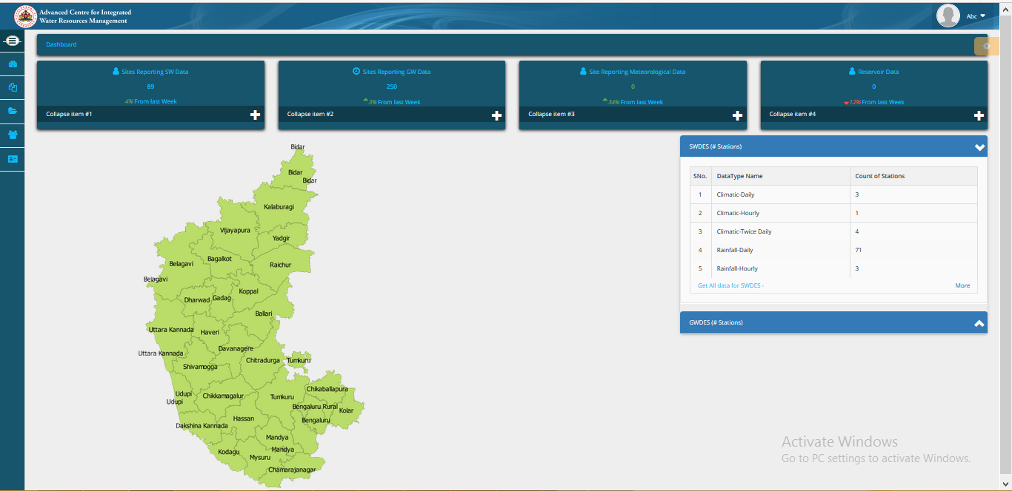
Karnataka Water Resources Information System (KWRIS)

Slide 22
Status of Public Finance Management System(PFMS)
Training in PFMS to accounts staff has to conducted before its implementation.
WRD

Slide 23
DEVELOPMENT OF IWRM PLAN FOR KRISHNA BASIN
ACIWRM started setting up the Source Model for Tungabhadra & Vedavathy (K8 & K9) river basins
Trained 6 engineers of WRD with eWater in Australia; another 6 engineers training started and will be trained during Sept. in Australia
River basin profile prepared for Tungabhadra & Vedavathy (K8 & K9) river basins; River basin plan being prepared with IWRM principles
ACIWRM will identify and test different water management scenarios in K8 & K9 Sub basins using Source model
ACIWRM will develop IWRM plans incl. Source models for K2, K3, K4 & K6 sub-basins of Krishna basin
Climate change modeling completed for K8 basin; other basins is under progress
IWRM training completed for 84 engineers of WRD

Slide 24
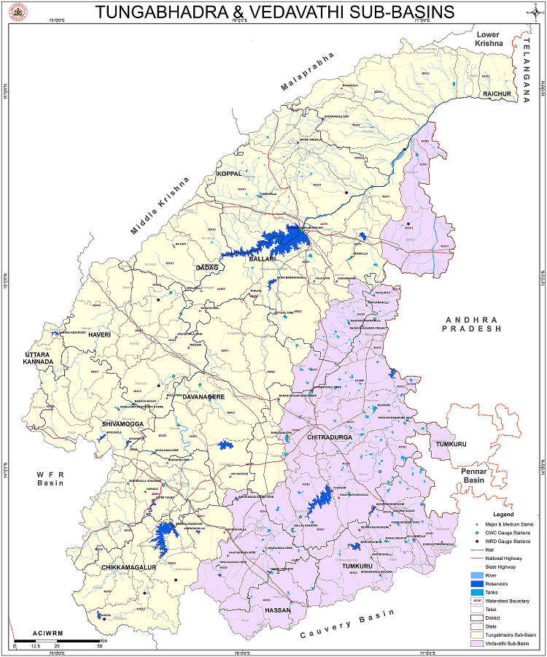
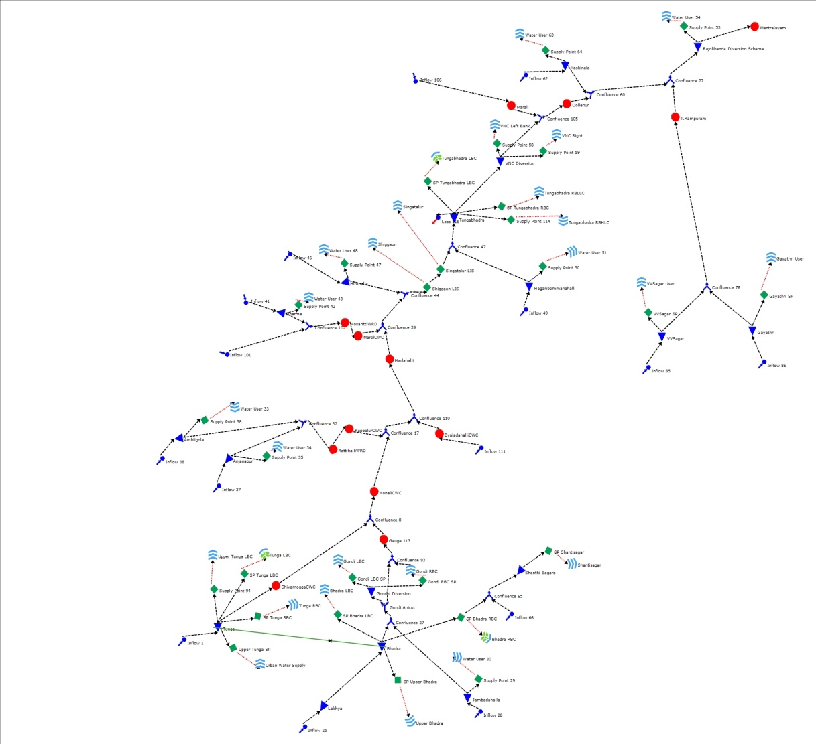
RIVER BASIN MODELING USING SOURCE
A Source model built for the Tungabhadra River Basin
to support development of the IWRM plans

Slide 25
THANK YOU

